Slide 1
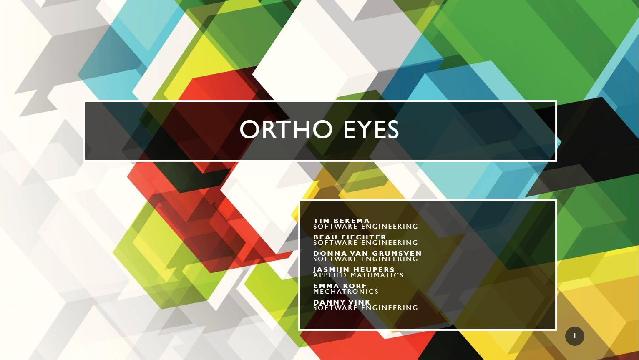
Ortho eyes
Tim Bekema
Beau Fiechter
Donna van Grunsven
Jasmijn Heupers
Emma Korf
Danny Vink

Slide 2
Table of contents
Ortho Eyes recap
Recap OR-Ensemble
Future of Ortho Eyes
Throwback previous public presentations
Week 4 goal results
Week 8 goal results
Week 12 results
Planning
Questions and feedback

Slide 3
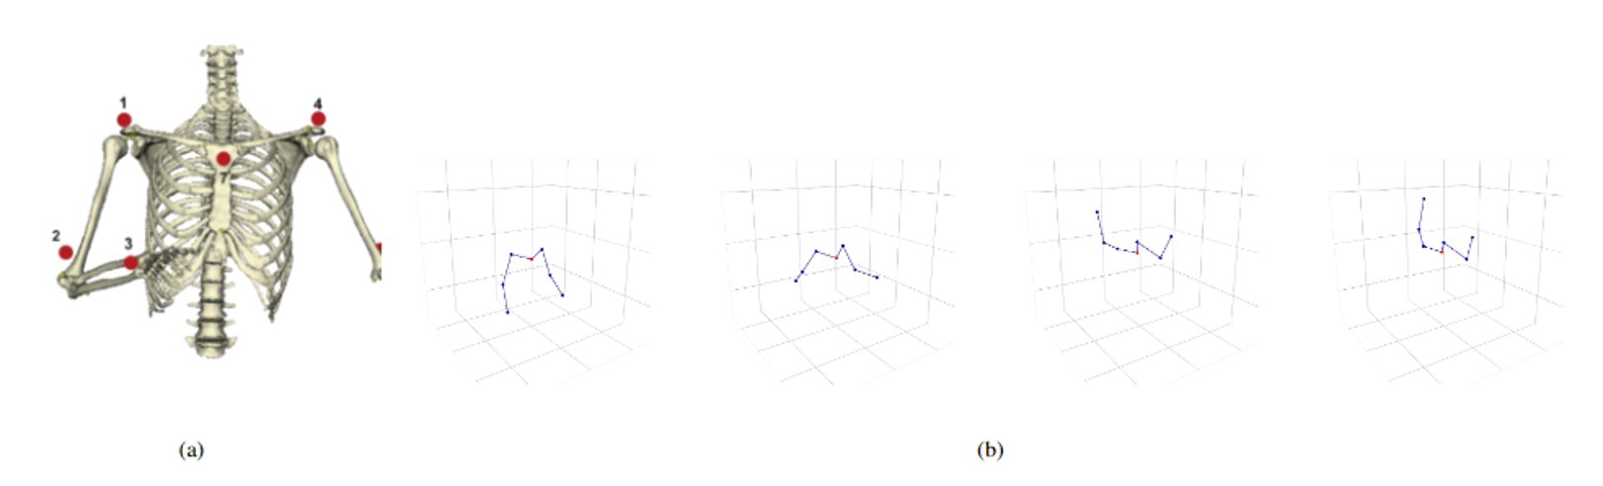
Ortho eyes recap
LUMC Medical Dataset made with a Flock of Birds system for shoulder injuries
Multiple iterations of Ortho Eyes
2020 focus: improving the OR-emsemble of Vuurens, Andrioli and de Vlugt
“Which models can be added to the OR-ensemble to improve the classification of individuals to the correct patient group using the existing data from a Flock of Birds system?”

Slide 4

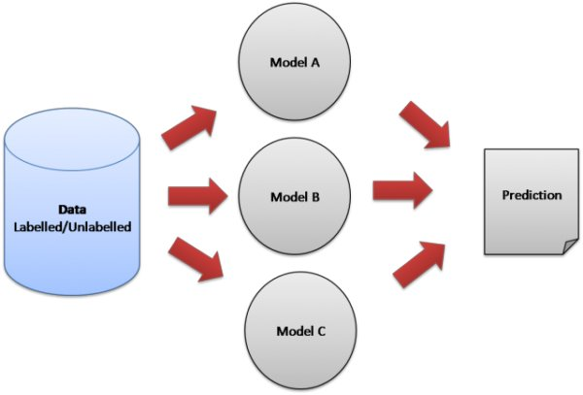



Recap OR-ensemble
Category 1 = no (0)
Category 3 = yes (1)
Boolean OR
Max height left wrist
Max height right elbow
Category 3
Max angle right shoulder
Notes:
- Ensemble learning
- For every feature a logistic regression model
Models can be seen as doctors
Doctors look at 1 specific feature
If 1 doctor says

Slide 5

Future of Ortho Eyes
2021: New protocol for gathering new data
Camera to analyze patients in the waiting room
Therefore, it’s our job to analyze and select medically accountable features!

Slide 6
Throwback
Week 4
Data visualization
Goal: create a model for classification between group 1-3 > 70% accuracy
Week 8
First version OR ensemble
Goal: research to add more features and understanding the Euler angles
Week 12
Current focus: Feature selection
OR-ensemble Research paper

Slide 7
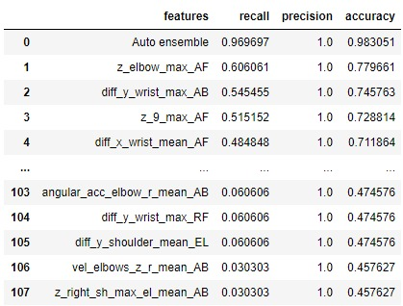
Week 4 goal
Our current experiment:
“Create a model where the accuracy in classifying between group one and three is at least 70%”
Results week 12:
107 features
Factor: 1.1
Auto OR-ensemble: 96% recall and 98% accuracy
Therefore we have to look at collinearity

Slide 8
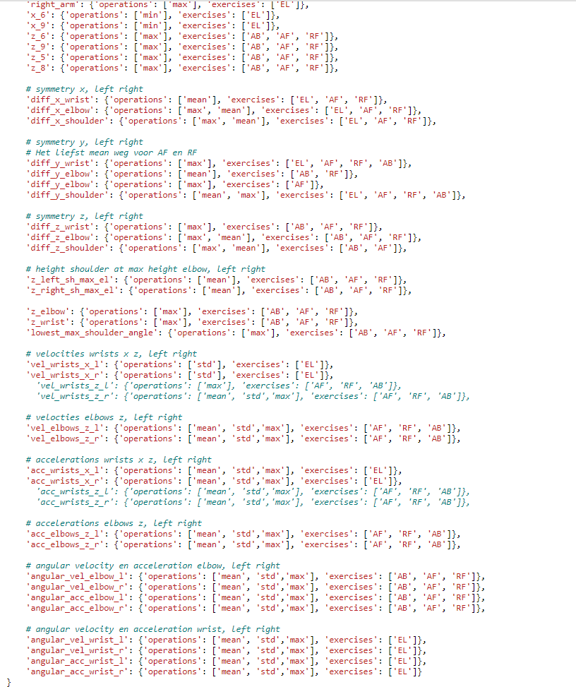
Week 8 goal
“Research to add more features and understanding the Euler angles”
Results week 12: - 41 features which provided 168 combinations - Euler angles: not relevant for future end goal

Slide 9
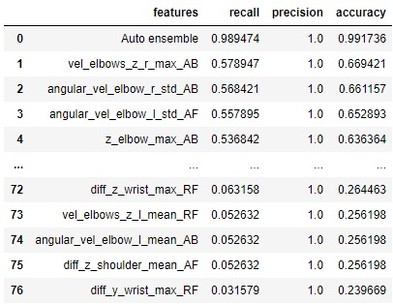
Week 12 results
Week 12 improved OR-ensemble to classify category 1 vs all
Results
Improved the current OR-ensemble
Compared it to other models (Random Forest, SVC, AdaBoost, Bagging)
Factor hyperparameter research
Sliced/cleaned all patient groups
Started writing research paper
Goals
OR-ensemble binary tree research
Decide definitive features
Continue writing research paper
76 features, factor: 1.5, recall: 98%, accuracy: 99%

Slide 10
Week 12 results
Factor slider visualization
Results
Improved the current OR-ensemble
Compared it to other models (Random Forest, SVC, Decision Trees)
Factor research
Sliced/cleaned all patient groups
Started writing research paper
Goals
OR-ensemble binary tree research
Decide definitive features
Continue writing research paper

Slide 11
planning
Week 12
Feature selection
Collinearity
Week 13
Perfecting the OR-ensemble
Testing
Physiotherapy protocol
Week 15
Last adjustments
Soft-deadline for project and paper
Week 14
Research paper
Portfolio

Slide 12
planning
Christmas break
Week 16
Written test
Week 18
January 22
Final presentation
Week 17
Finishing touch
Paper submission review
Portfolio review

Slide 13

Questions or feedback?

